Slide 1

PICO SSCS Aristotle University of Thessaloniki novel boost converter for battery-powered IoT applications
Team members
B. Eng. Kontogiannis Stefanos
M. Eng. Andreas Tsiougkos
B. Eng. Nikos Ladias
Notes:
Hello everyone, this is team Greece, and we will present our novel boost converter topology designed in Skywater130 technology.

Slide 2
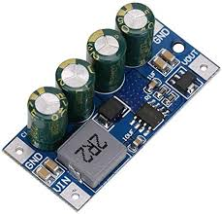
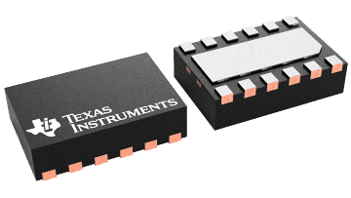
State-of-the-art LDO/DC-dc converters
Increasing need for efficient power management
E.g., due to IoT evolution
Improved lifecycle product management, maintenance costs
Typical power converter circuits
PWM boost/buck converters
Switched Capacitor / Charge Pump
Boost Converter by OEM manufacturer for Wal Front
Texas Instruments TPS 61094 PWM Boost control module
New novel boost converter topology​
Non PWM, high load current, operating at low battery voltages​
Notes:
1 min

Slide 3
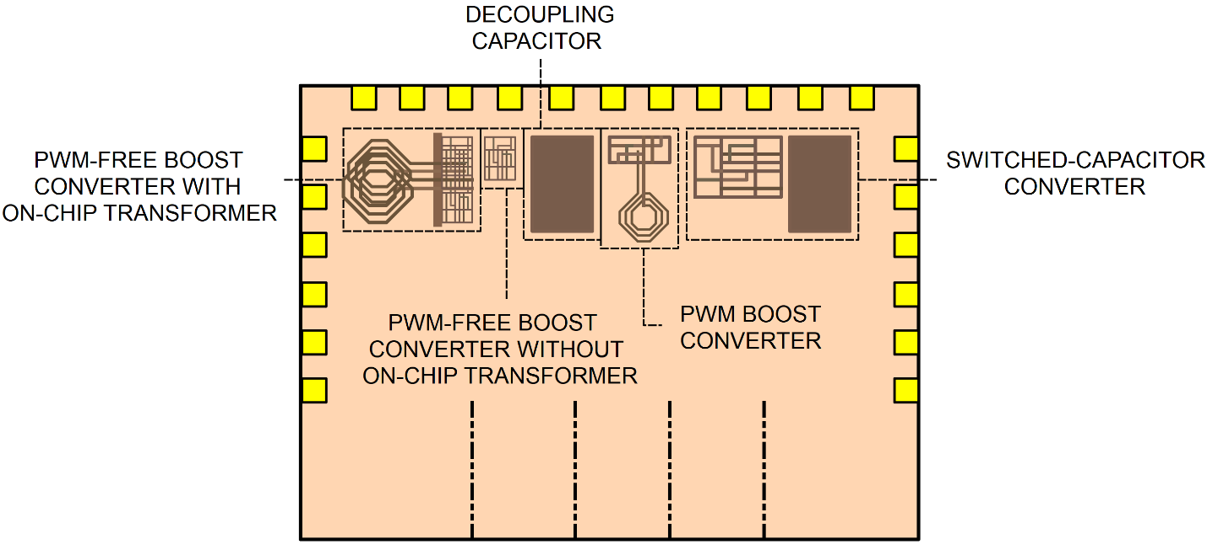
Design Summary and Goals
Comparison among the non-PWM boost converter and the other topologies
Explore/investigate various load currents and minimum output voltages
Measure power efficiency, load regulation, quiescent current
1.5 V battery source scenario → Input voltage drops due to the battery’s gradual discharge
Four circuit blocks
Notes:
This project aims to evaluate a novel non-PWM boost converter for extending battery life in IoT applications. The proposed converter will be compared to a traditional PWM boost converter and a switched-capacitor boost converter. The purpose is to perform a comparative analysis between the non-PWM boost converter and the other topologies for a 1.5 V battery source scenario in order to demonstrate the significance and, possible, limitations of the non-PWM boost converter via the metrics of power efficiency, load regulation, and quiescent current. We aim to compare their performance characteristics for various load currents and minimum output voltages and examine their peak efficiency as the input voltage drops due to the battery gradual discharge, thus concluding the useful lifetime they allow when leveraged by our converter.

Slide 4
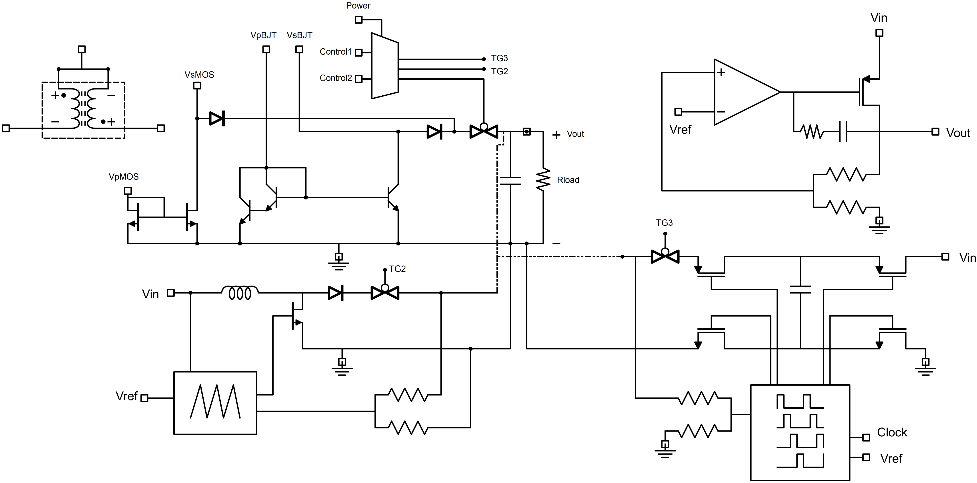
System Block Diagram
Notes:
Run through the circuits.
Common output node isolated through diodes and transmission gate

Slide 5
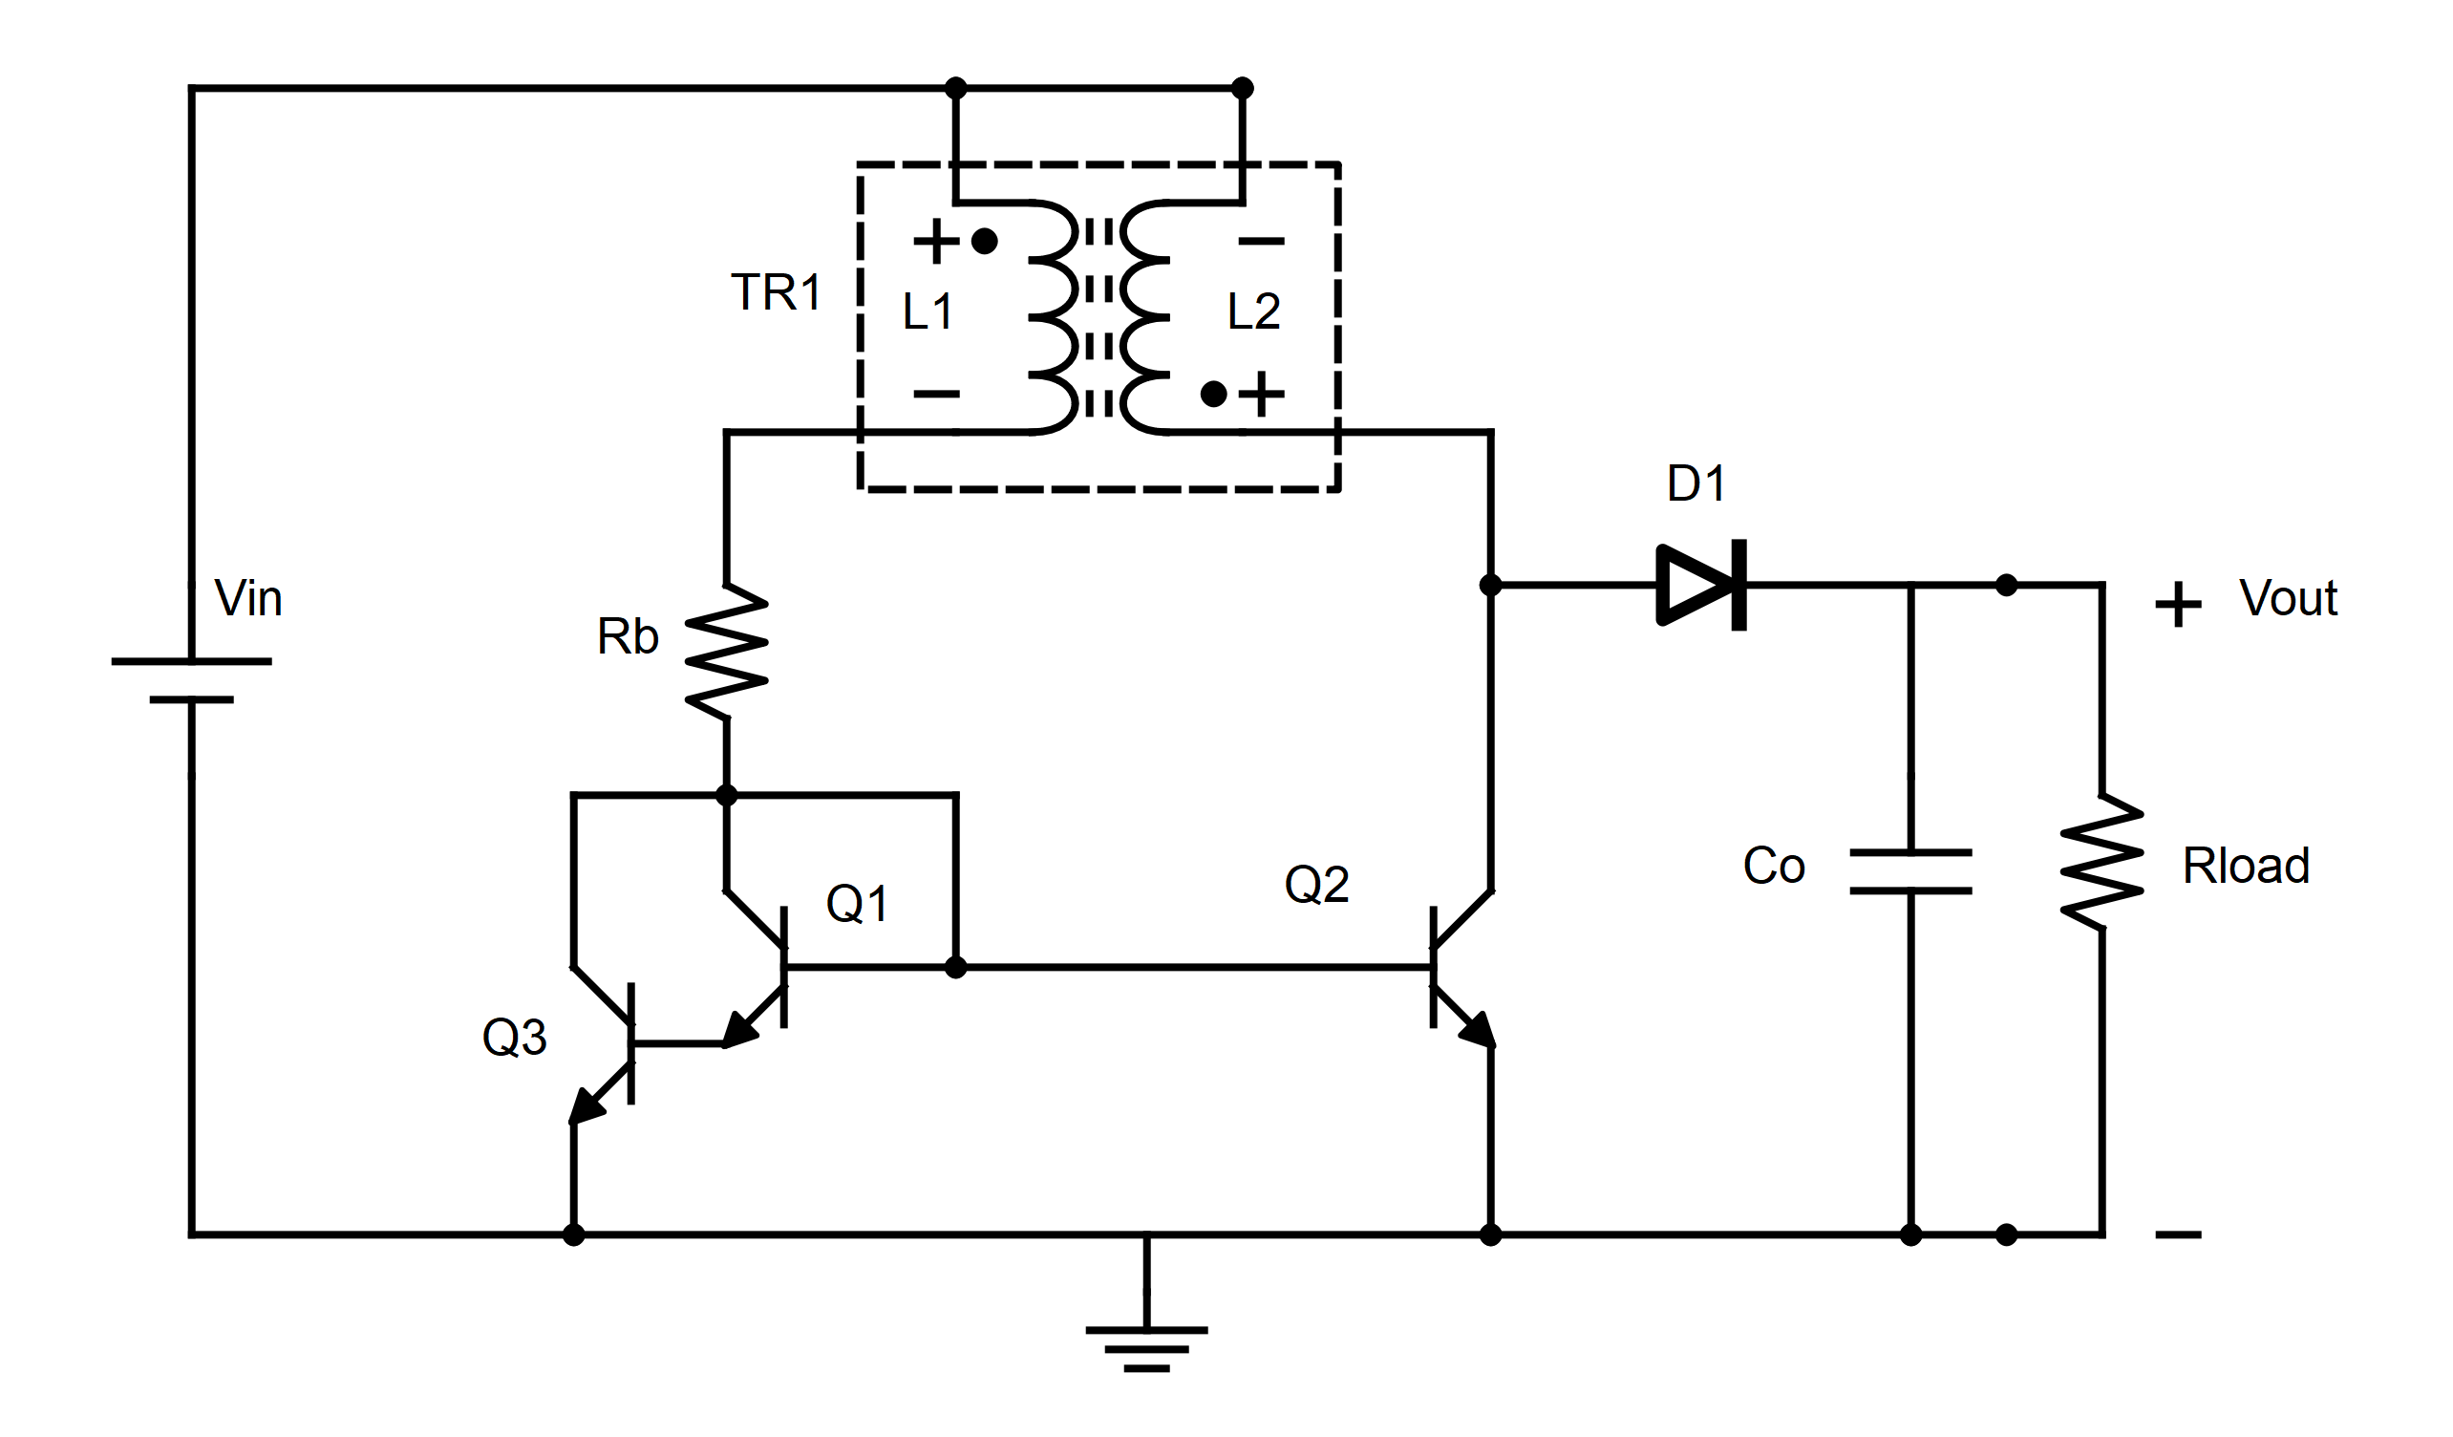
Non-PWM Boost Converter
BJT current mirror
Transformer → Positive feedback
Frequency related to transformer parameters
Supplementing with external transformer
Notes:
The circuit consists of a bipolar junction transistor current mirror connected to a transformer with inverted secondary coil, as shown, forming a closed loop and generating positive feedback for voltage boosting. The current mirror transistor on the output side is driven by a pulse train and it determines the output voltage. The frequency of the pulses is largely determined by the transformer characteristics and the selected output objectives.

Slide 6
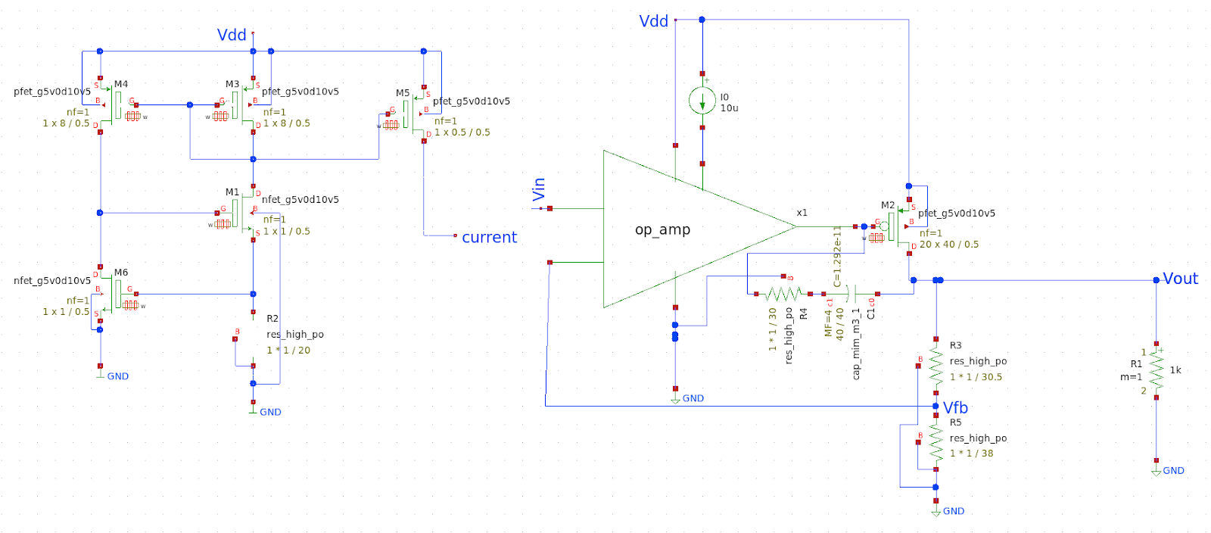
Low Dropout Regulator
No output voltage regulation → LDO
20 to 50 mV voltage drop
Maximum input voltage 8 V
Quiescent current < 30 uA
Various input / output voltages and loads
Notes:
2.5 V -> 1.2 V 60 mA
2.5 V -> 1.8 V 45 mA
3.3 V -> 3 V 35 mA
A Linear Dropout Regulator (LDO) is connected to the output of the PWM-free boost converter to eliminate output voltage ripple. This circuit utilizes a feedback signal generated from a resistor divider to control the on-resistance of a pass device through an error amplifier. This way, the output signal is constantly corrected and thus stabilized. A PMOS-regulator based topology is used for the pass element since these kinds of topologies present lower dropout voltages in general.
Considering a supply of 2.5V, the LDO is designed to stabilize at 1.2V with a dropout voltage of almost 20mV and a voltage reference input of 0.65V. At this supply voltage, It can also stabilize at 1.8V with a 1V reference input signal and a comparable dropout voltage. For a supply of 3.3V, it can stabilize at 3V with a reference signal of around 1.65V and a dropout voltage of about 30mV. The total quiescent current of the entire topology is less than 30 μA.

Slide 7
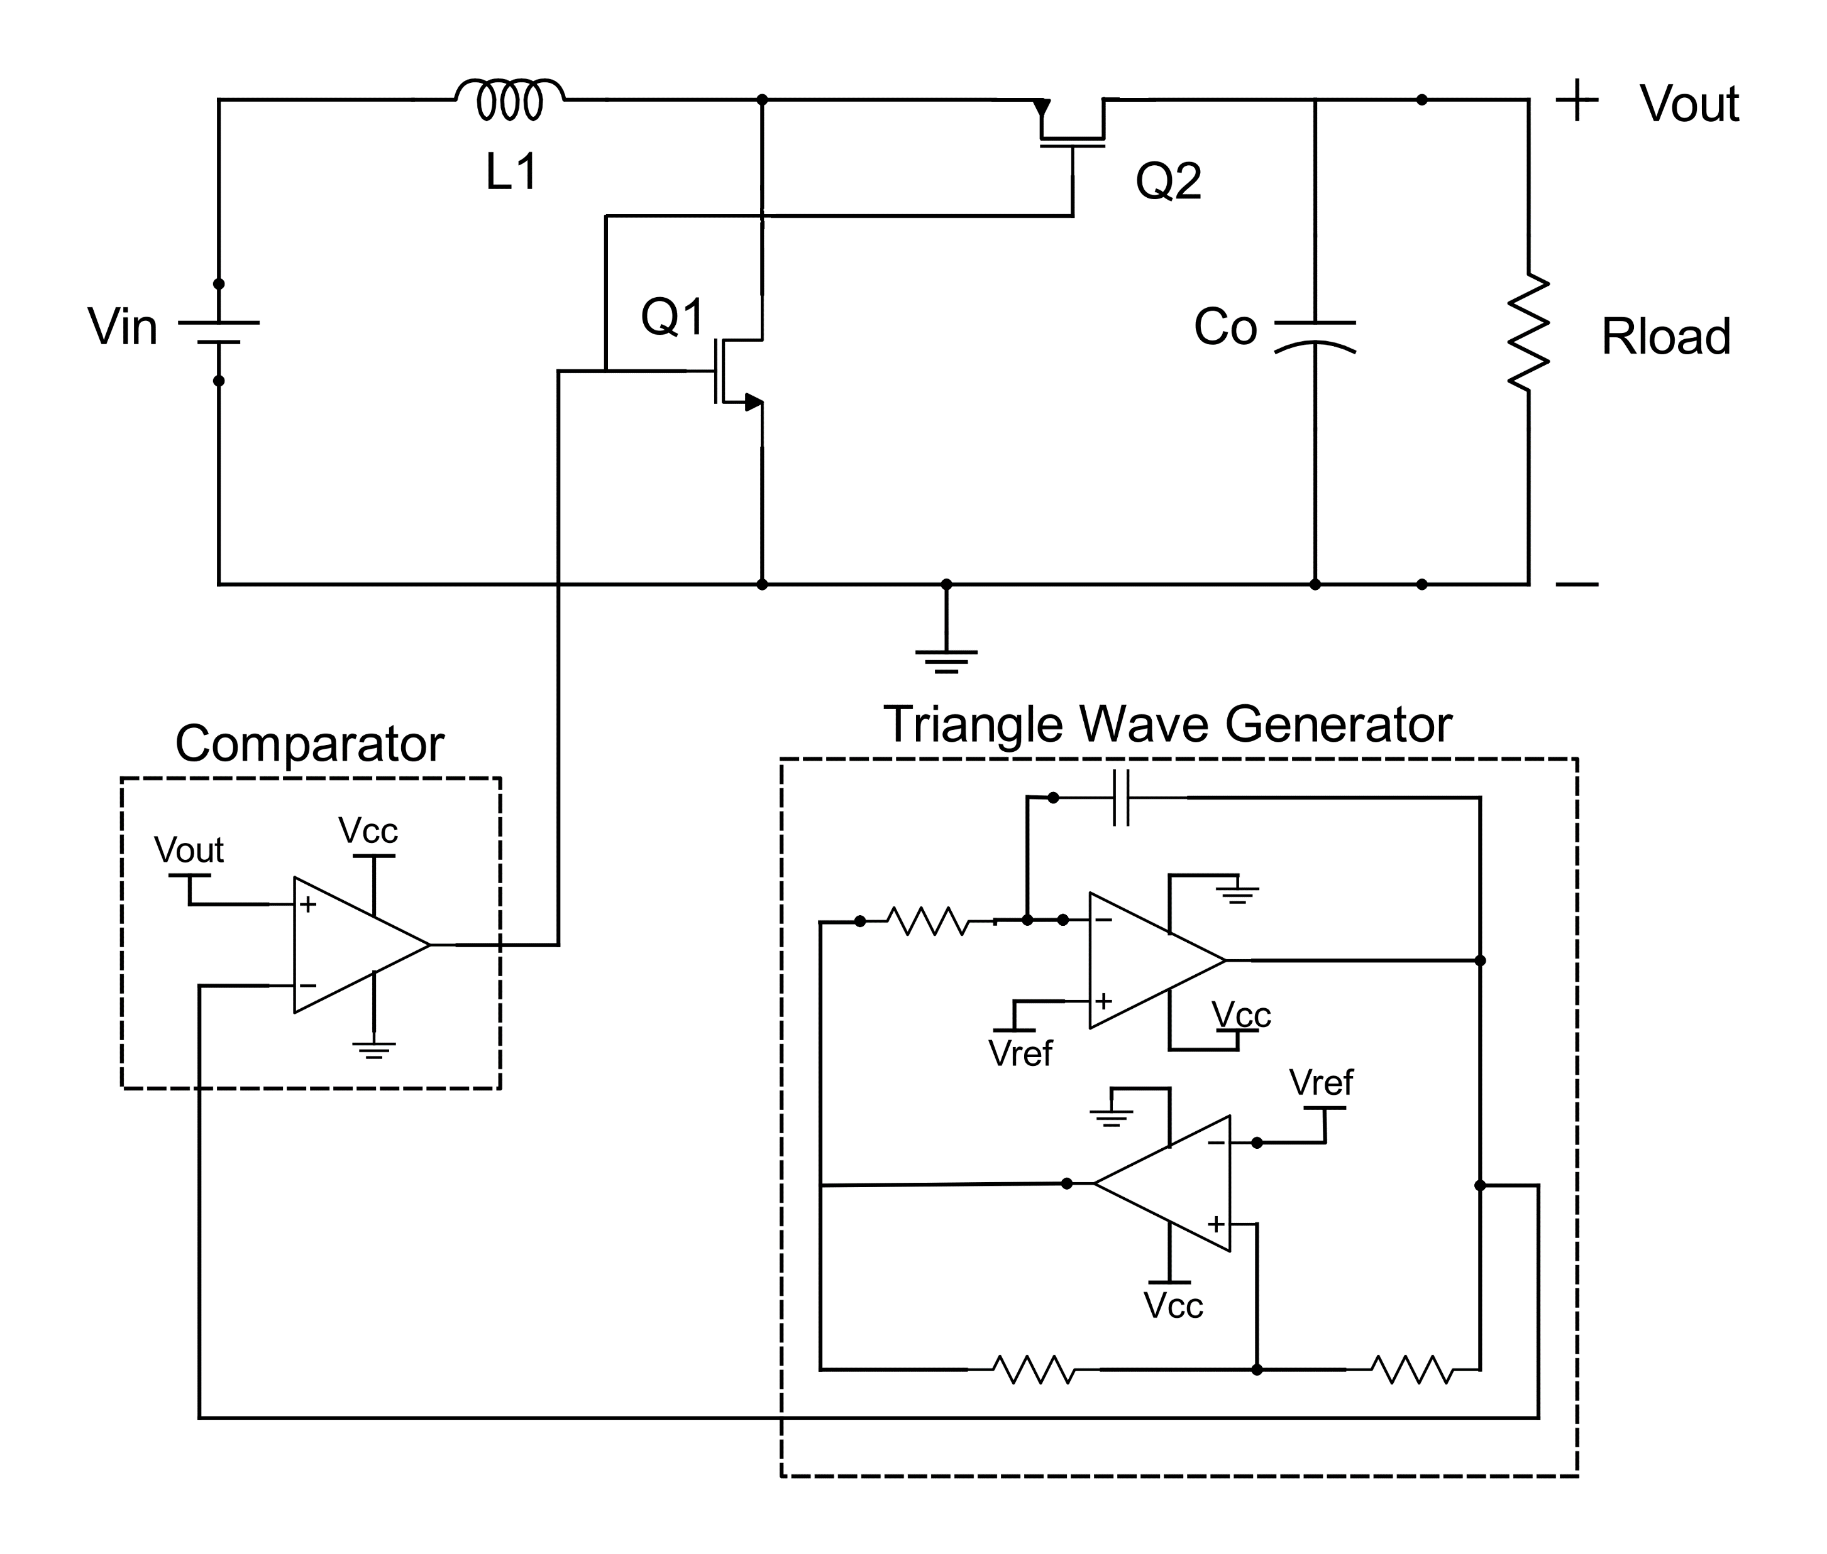
PWM Boost Converter
Triangle wave generator and comparator
Output voltage regulation
Coil inductance →
frequency of operation
mode of operation
Notes:
The PWM boost converter contains a PWM block on chip, consisting of a Schmitt trigger and an Integrator that feeds a Comparator. Through its feedback, this implementation can provide satisfying output voltage regulation but with the associated overhead in power incurred by the PWM block.

Slide 8
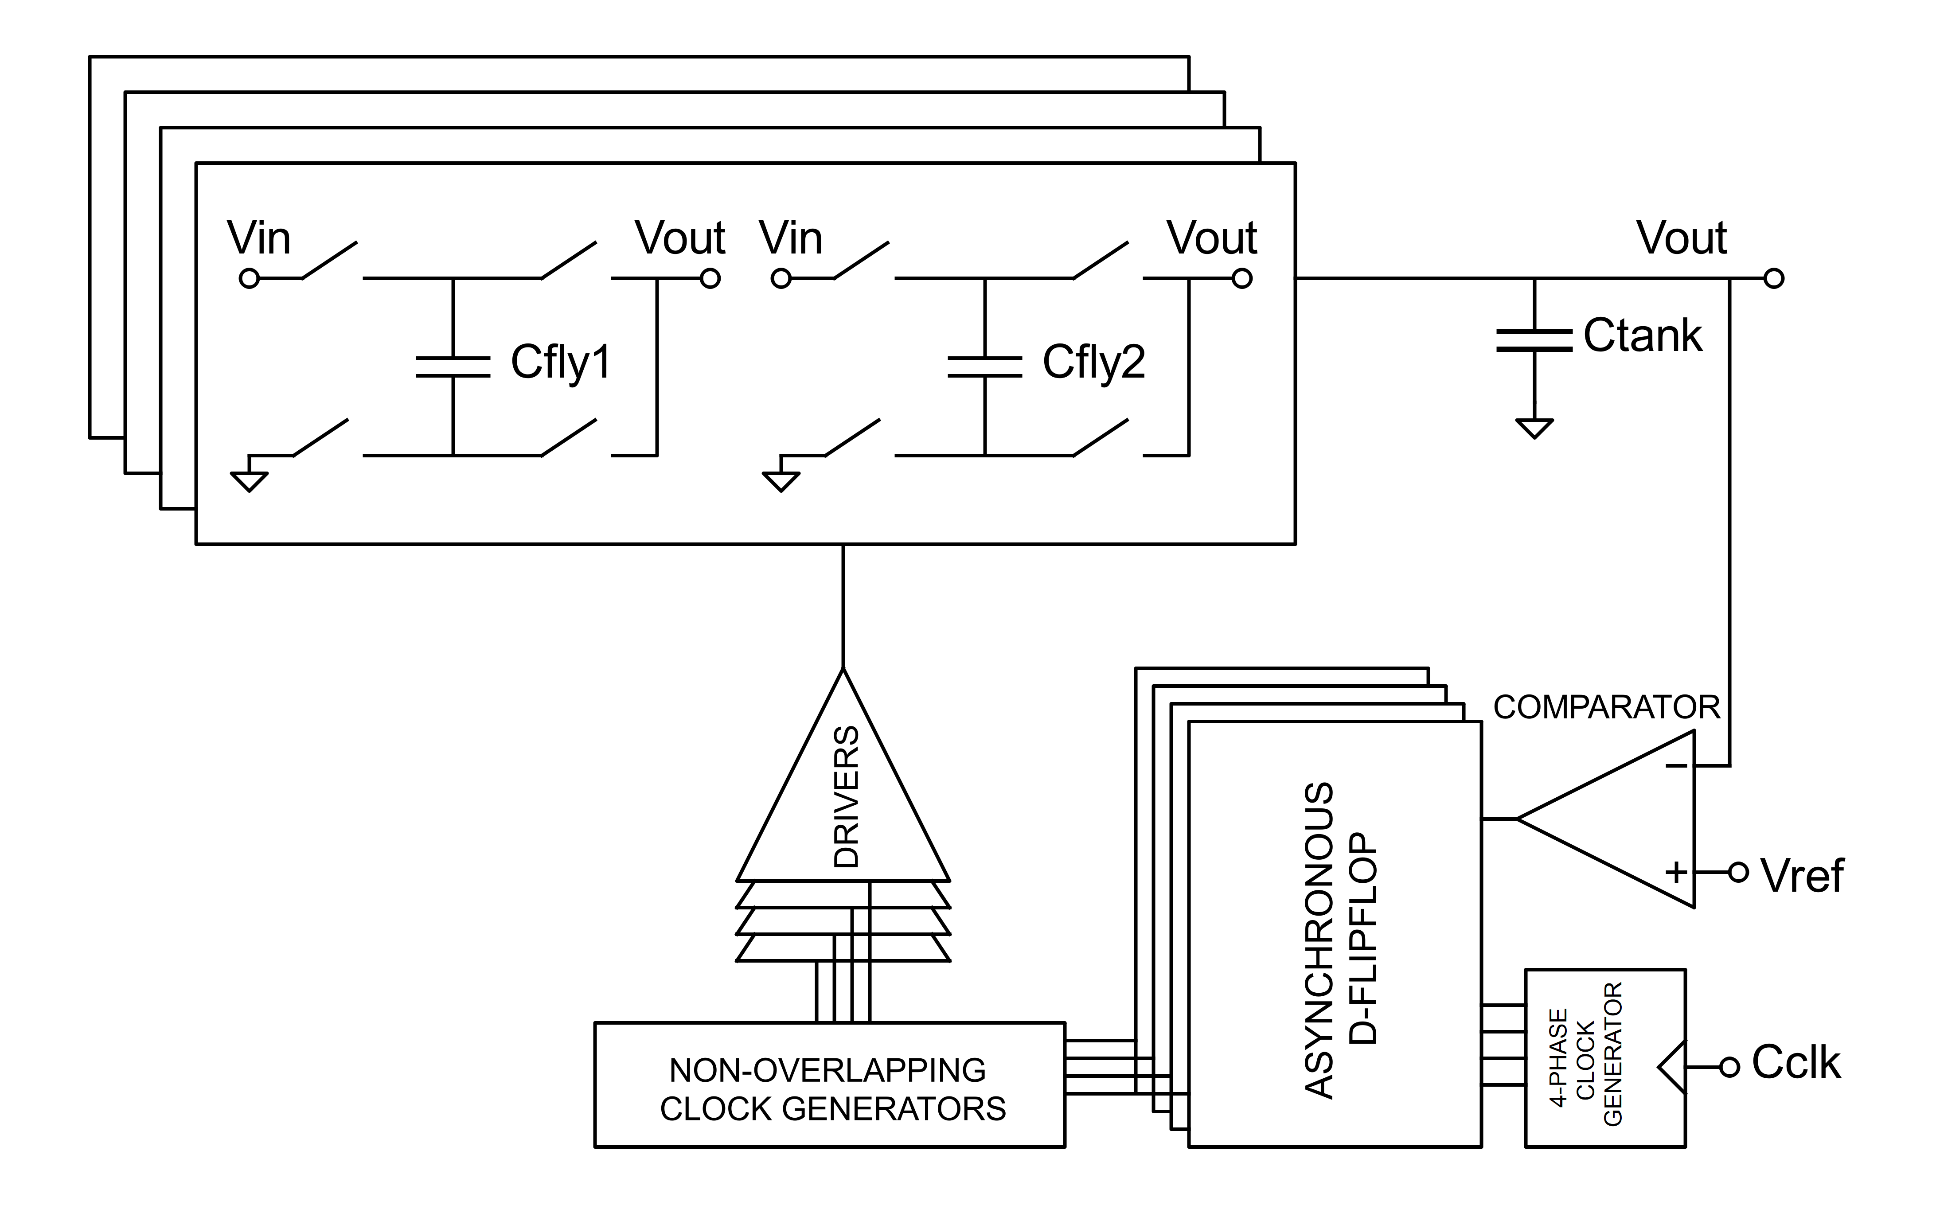
Switched Capacitor Circuit
Four-phase function
Output voltage regulation
Non-overlapping phases
Burst-mode pulse frequency modulation
Tank capacitor
Notes:
The switched-capacitor circuit will consist of a four-phase non overlapping clock generator and a four-stage parallel charge pump. It implements a burst-mode pulse frequency modulation to achieve better efficiency in a large range of loads.

Slide 9
simulation results and verification

Slide 10
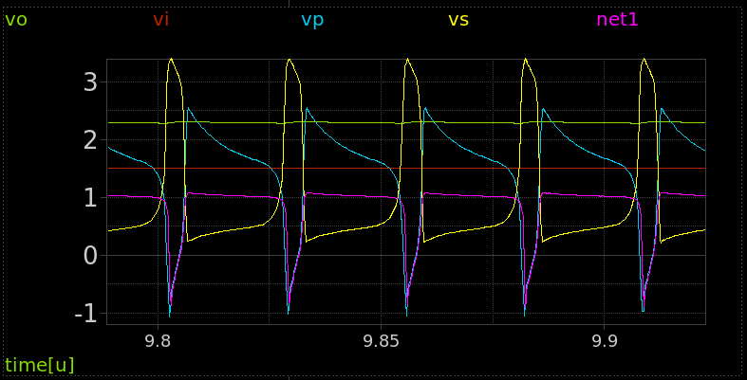
Non-PWM Boost Converter
Oscillation start-up possible issues
On-chip / off-chip transformer versions
Efficiency vs Power control though primary branch resistor
Tests for input voltage of 1.5 V all the way down to 0.7 V for external transformer
Comparison with prototype board
Notes:
BJT 1.5 V -> 5 mA 2.2 V
1.2 V -> 5 mA 1.8 V
MOS 100 Ohm 1.5 V -> 20 mA 2.4 V, 1.2 V -> 10 mA 1.8 V, 0.7 V -> 10mA 1.7 V
50 Ohm 1 V -> 10 mA 3.7 V, 1 V -> 20 mA 2.8 V, 0.7 V -> 10 mA 1.8 V

Slide 11
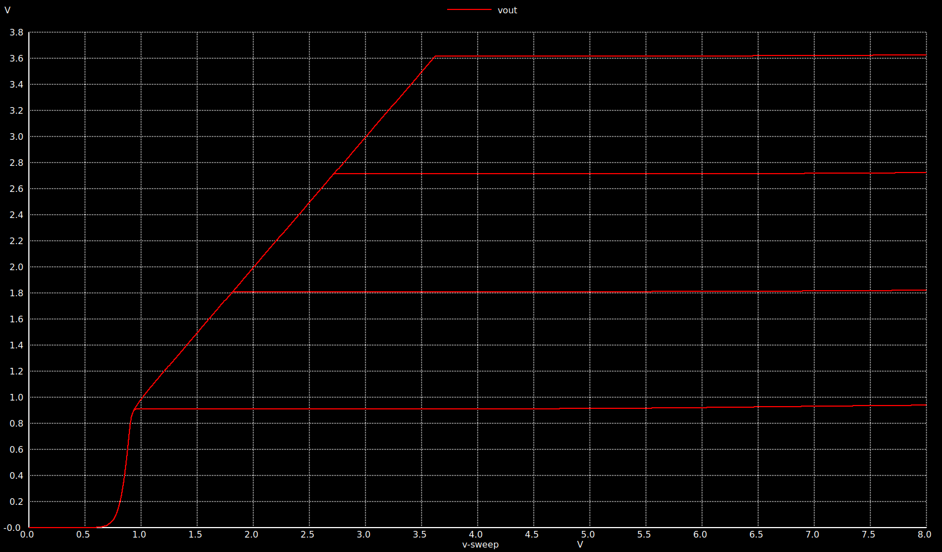
Low Dropout Regulator
Small and able to cover all load cases
Particularly we are interested in 2.5 – 3.3V regulated to 1.2 V and 1.8 V
Notes:
2.5 V -> 1.2 V 60 mA
2.5 V -> 1.8 V 45 mA
3.3 V -> 3 V 35 mA

Slide 12
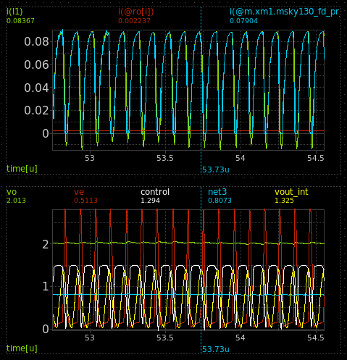
PWM Boost Converter
Regulation ability
Option of external supplementation of inductance for operation at different loads
Control block sensitive to input voltage drop due to rail-to-rail function
Max load measurements at coil boundary conduction mode
Max efficiency measurements at coil continuous conduction mode
Notes:
1.5 V -> 2 mA 2 V 200 nH
Inductor size determines everything

Slide 13
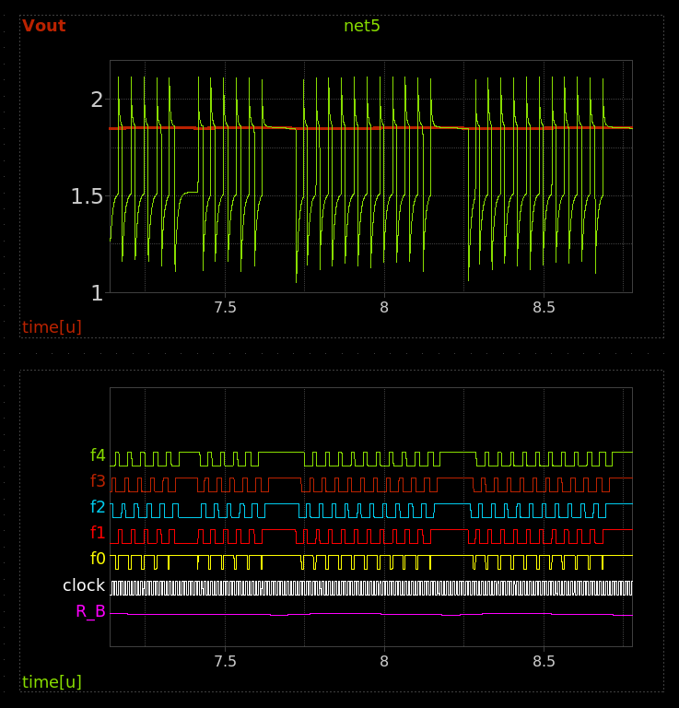
Switched Capacitor Circuit
Burst mode functionality verification
Load capability directly tied to size and clock frequency
0.5 mA to 1 mA at 1.8 V for 60 MHz clock → bare pad to push higher

Slide 14
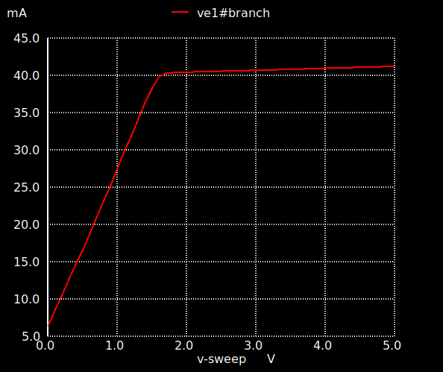
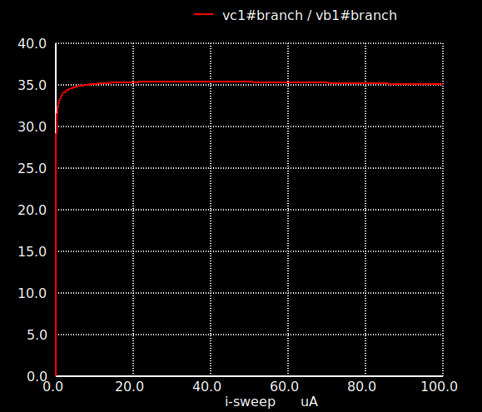
Devices
BJT array β and curve for the novel boost converter’s mirror main transistor

Slide 15
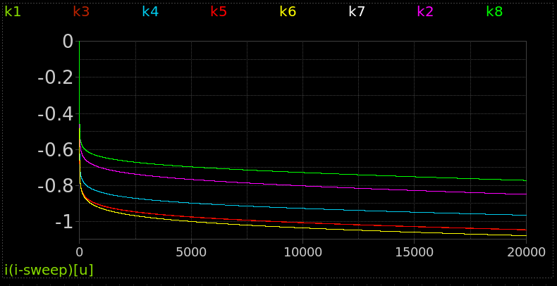
Devices
400 mm² diode curves → pw2nd 11v
Need small forward voltage drop, leakage is secondary.

Slide 16
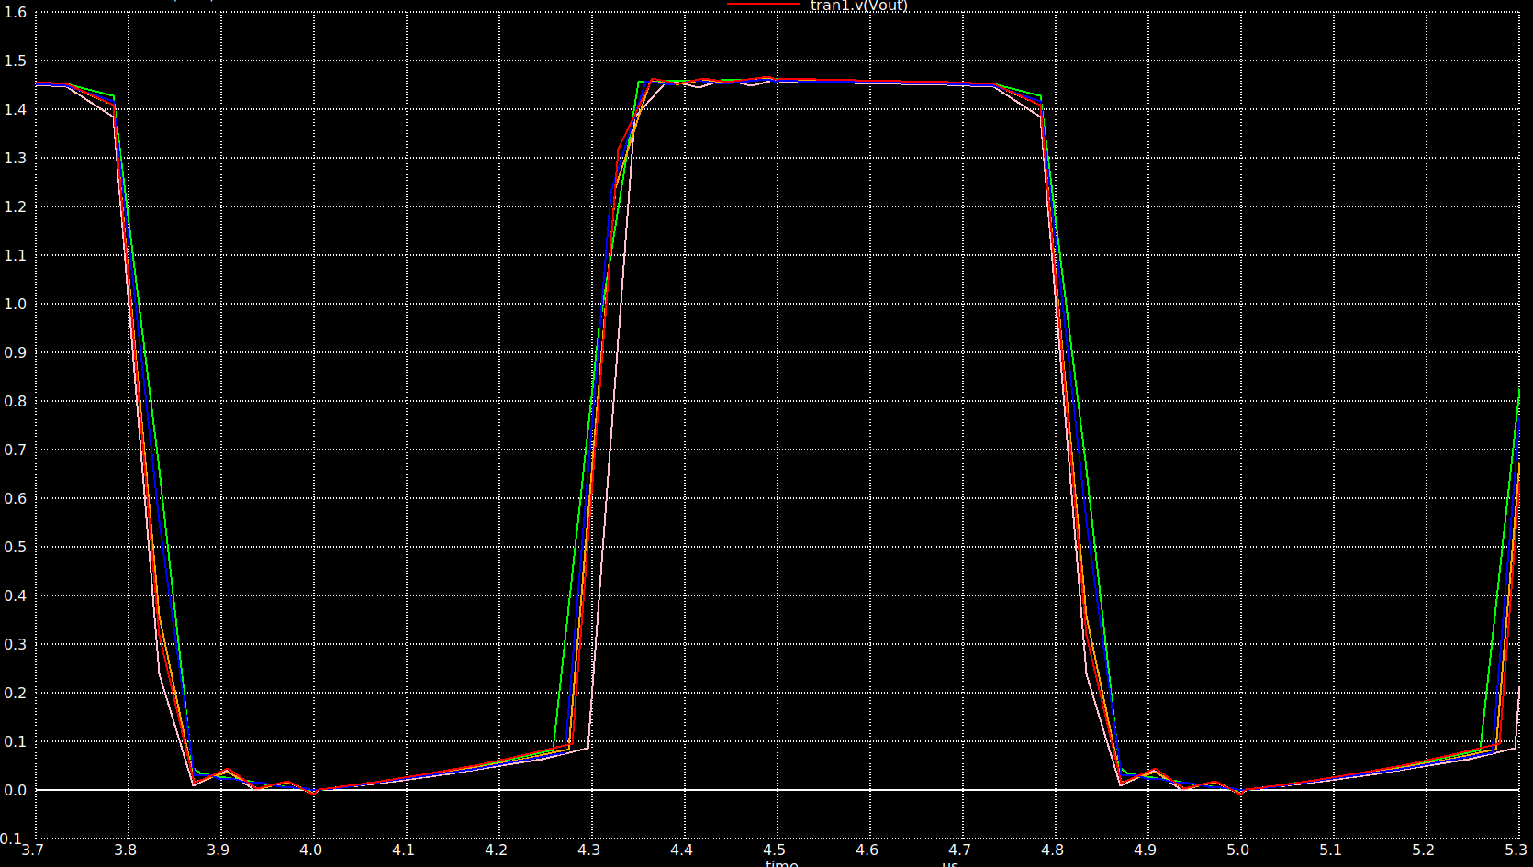
Monte Carlo Simulation
Most circuit block functions are very resistant to process variation
Observed either small changes in frequency or small offsets in differential amplifier stages
Vref external signal can easily trim such effects from mismatched transistors or divergent voltage dividers

Slide 17
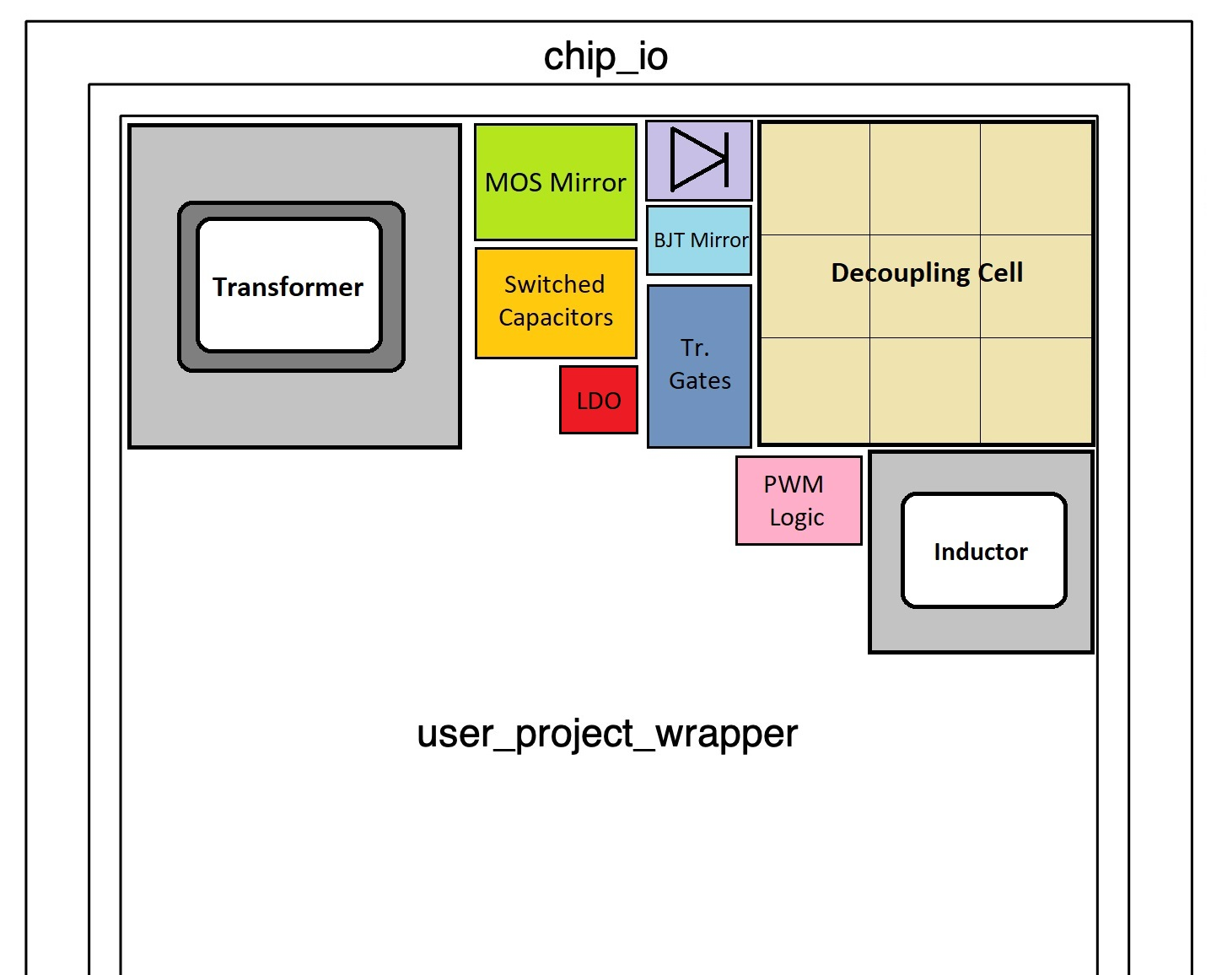
Area estimate
Our circuit should fit within 3.5 mm², biggest blocks:
On-chip Transformer
Decoupling cell
Decoupling cell can be shared with other teams.
All circuits attached to it are isolated by diodes or transmission gates. Charging the cell externally with all circuits inactive would lead to a quiescent current draw of ~50 μΑ.
Notes:
A tentative layout of the system can be seen in the figure above. A maximum area of 1 mm² is allocated to the transformer of the novel boost converter. The transformer structure will reside at the top three metal layers. An area of 100 μm by 80 μm is reserved for three NPN BJT grids, and an area of 440 μm² is allocated to the output diode.
The MOSFET mirror takes up an area of 150 μm by 250 μm, has its own 440 μm² diode and shares a transmission gate with the BJT mirror, whose size is 200 μm by 130 μm.
The PWM boost converter features an on-chip inductor with an area of 600 μm by 600 μm, a 440 μm² diode, a 110 μm by 65 μm inductor switch and a triangular wave generator with a comparator/regulator taking up 85 μm by 80 μm. It also has a 200 μm by 130 μm transmission gate.
The switched capacitor circuit is mostly composed of four capacitor banks whose area totals 160 μm by 320 μm. A small clock and regulation logic and a few switches are also present and can fit beneath the capacitor banks. This circuit also features a 200 μm by 130 μm transmission gate.
The three circuits will be sharing a single output capacitor with an area of 1 mm² and an estimated capacitance of 6 nF. This decoupling cell is built using MiM capacitors at metal layers 3, 4 and 5 as well as a MOSCAP. Its connection will be switched between the three circuits by use of the test setup inputs.
The multiplexer, switching the output of the circuits, has an area of 100 μm by 80 μm and drives the aforementioned transmission gates.
The approximate area of the entire LDO is about 80 μm x 80 μm.

Slide 18
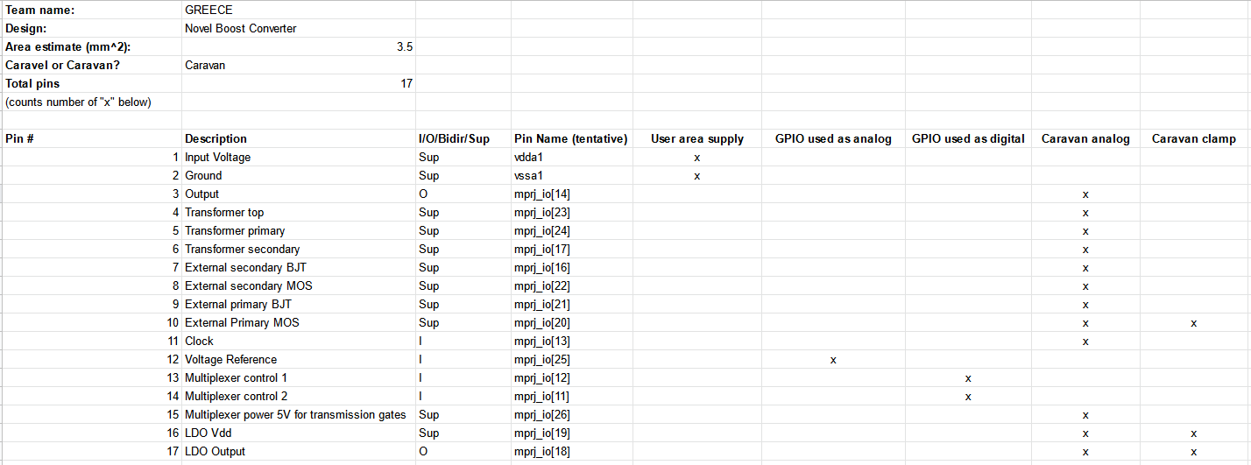
Pin-list
Need for 17 pins, 12 of which analog.
Pins are estimated to have a worst case of 1.25 nH inductance for the corner bondwires (longest wire + 30% for height difference) and a resistance of 0.05 Ω. Chip pad capacitance is estimated to be around 1 pF at worst for bare pads (without later ESD diodes contribution).

Slide 19
Caravel Sharing
Need for analog pins, some sharing possible.
Austria, 1 analog pin, 0.5 mm²
Chile1, no analog pins , 2.5 mm²
India, no analog pins , 4 mm²
Pakistan1, no analog pins , 2 mm²
Pakistan2, no analog pins , 5 mm²

Slide 20
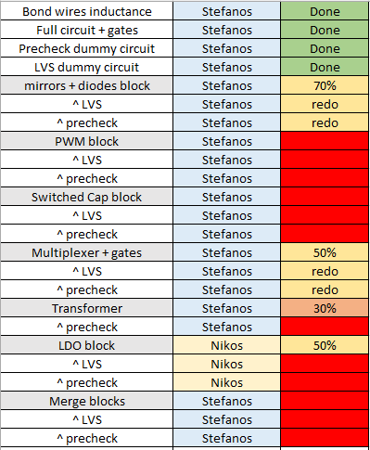
Schedule and milestones
Team full layout by October 15
Fully modular, broken into semi-independent blocks
Working in isolation and as a whole
Team merge by October 25
Arising problem solving until November 7+

Slide 21
Thank you!

